Slide 1




NEXT GEN EMPLOYABILITY PROGRAM
Creating a future-ready workforce
Team Members
Student Name :VANITHA M
Student ID :au620321104112
College Name
Bharathiyar Institute of Engineering for Women,Salem.

Slide 2

CAPSTONE PROJECT SHOWCASE
Project Title
Building Bus Reservation System using Python and Django
Abstract | Problem Statement | Project Overview | Proposed Solution | Technology Used | Modelling & Results | Conclusion

Slide 3
Abstract
The Bus Reservation System is a web application designed and implemented using the Django framework, offering a comprehensive solution for managing bus bookings efficiently. The system provides users with a user-friendly interface to browse available bus routes, view seat availability, make reservations, and manage their bookings seamlessly.
Administrators have access to a robust backend interface to manage bus schedules, routes, seat allocation, and user accounts. Leveraging Django's built-in features such as authentication, ORM (Object-Relational Mapping), and templating system, the Bus Reservation System ensures security, scalability, and maintainability.
With its intuitive design and robust functionality, the system aims to streamline the bus booking process, enhancing the overall user experience for both customers and administrators.
Source :

Slide 4
Problem Statement
The current manual process of bus reservation and management is cumbersome, inefficient, and prone to errors.
Traditional methods involve customers physically visiting bus terminals or making phone calls to book tickets, leading to long waiting times and potential booking inaccuracies.
Additionally, administrators struggle with managing bus schedules, seat allocations, and customer data manually, resulting in operational inefficiencies and customer dissatisfaction.
This system should offer users a seamless online booking experience, allowing them to browse bus routes, check seat availability, and make reservations conveniently from their devices.
Source :

Slide 5
Project Overview
User Registration and Authentication:
Users can create accounts securely to access the reservation system.
Authentication mechanisms ensure the security of user data and transactions.
Booking Management:
Administrators have access to a dashboard for managing bookings.
They can view and update booking details, including seat allocations and payment status.
Payment Integration:
Automated notifications are sent to users for booking confirmation, reminders, and updates.Notifications help keep users informed about their bookings and any changes to schedules.
Seat Availability and Booking:
Users can check seat availability for specific routes and dates.The system provides an intuitive interface for selecting seats and making reservations.
Source :

Slide 6
Proposed Solution
The proposed solution aims to develop a robust and user-friendly Bus Reservation System using the Django framework.
This system will automate the bus booking process for users while providing administrators with efficient tools for managing routes, schedules, and bookings.
By leveraging Django's features and adhering to best practices in software development, the solution seeks to enhance the overall user experience and streamline operations for both customers and administrators.
User Interface:
Develop a responsive web interface for users to browse bus routes, check seat availability, and make reservations.
Source :

Slide 7
Authentication and Authorization:
Implement user authentication mechanisms to secure user accounts and transactions.
Utilize Django's built-in authentication system to handle user registration, login, and password management.
Bus Route Management:
Create an admin interface for managing bus routes, including adding, editing, and deleting routes.Store route information such as departure city, destination, schedule, and fare in the database.
Seat Availability and Booking:
Integrate a seat reservation system that allows users to view available seats and select their preferred seats for booking.
Source :

Slide 8
Booking Management:
Develop an admin dashboard for managing bookings, enabling administrators to view, modify, or cancel reservations as needed.Include features for updating booking details, such as seat allocations, passenger information, and payment status.
Payment Integration:
Integrate with payment gateways (e.g., Stripe, PayPal) to facilitate secure online payments for bookings.Ensure compliance with industry standards and implement encryption protocols to protect sensitive payment information.
Reporting and Analytics:
Develop reporting tools to generate insights on booking trends, revenue, and other key performance metrics.
Source :

Slide 9


Technology Used
Front-end
Back-end
Source :

Slide 10
Modelling & Results
User model
Bus model
Route model
Seat model
Payment model
Source :

Slide 11
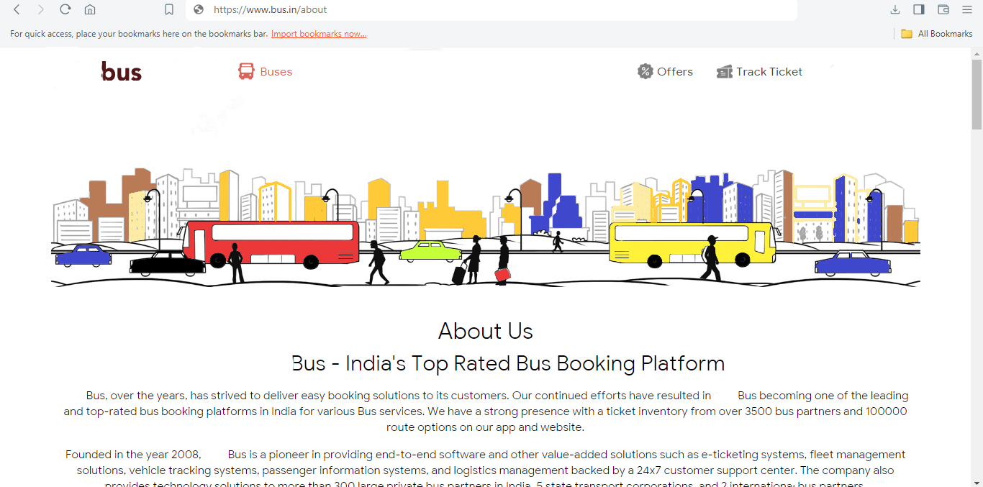
About-Us-Page

Slide 12
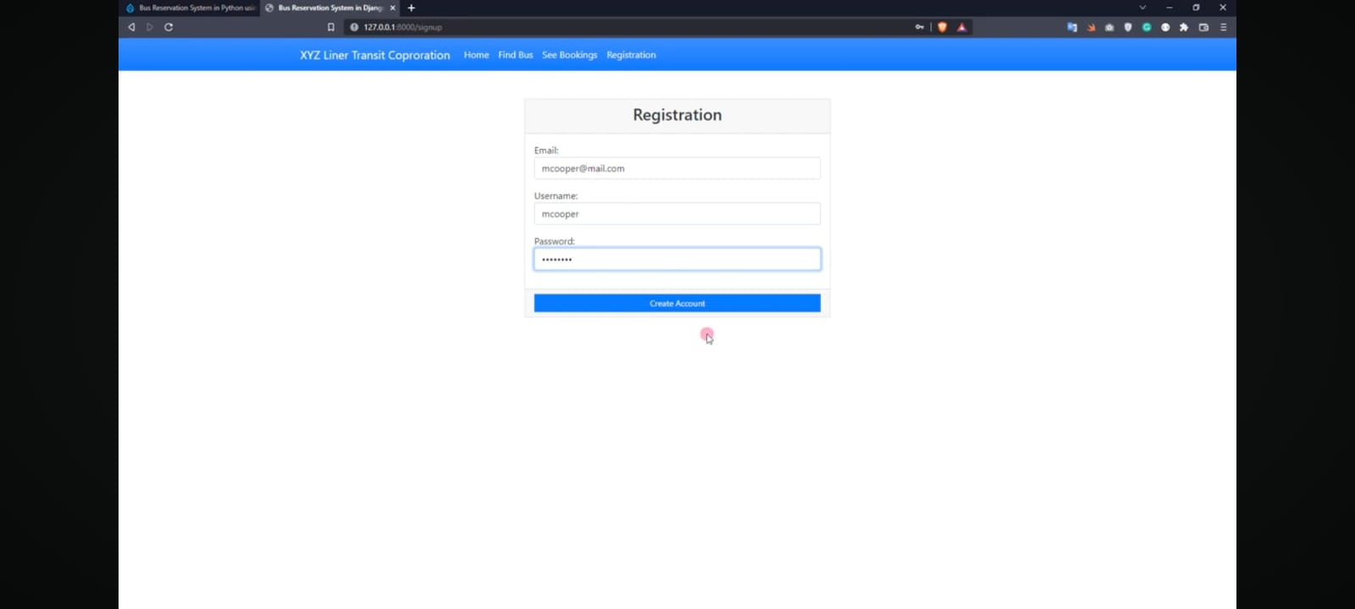
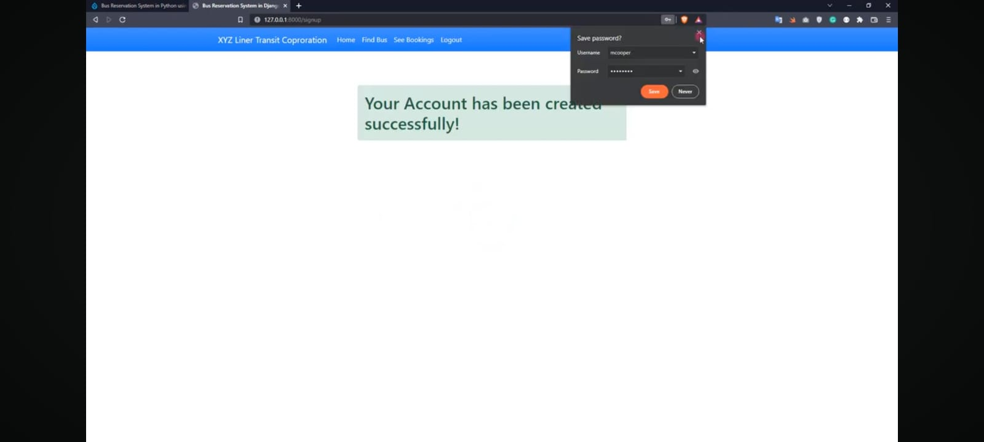
service-Page

Slide 13
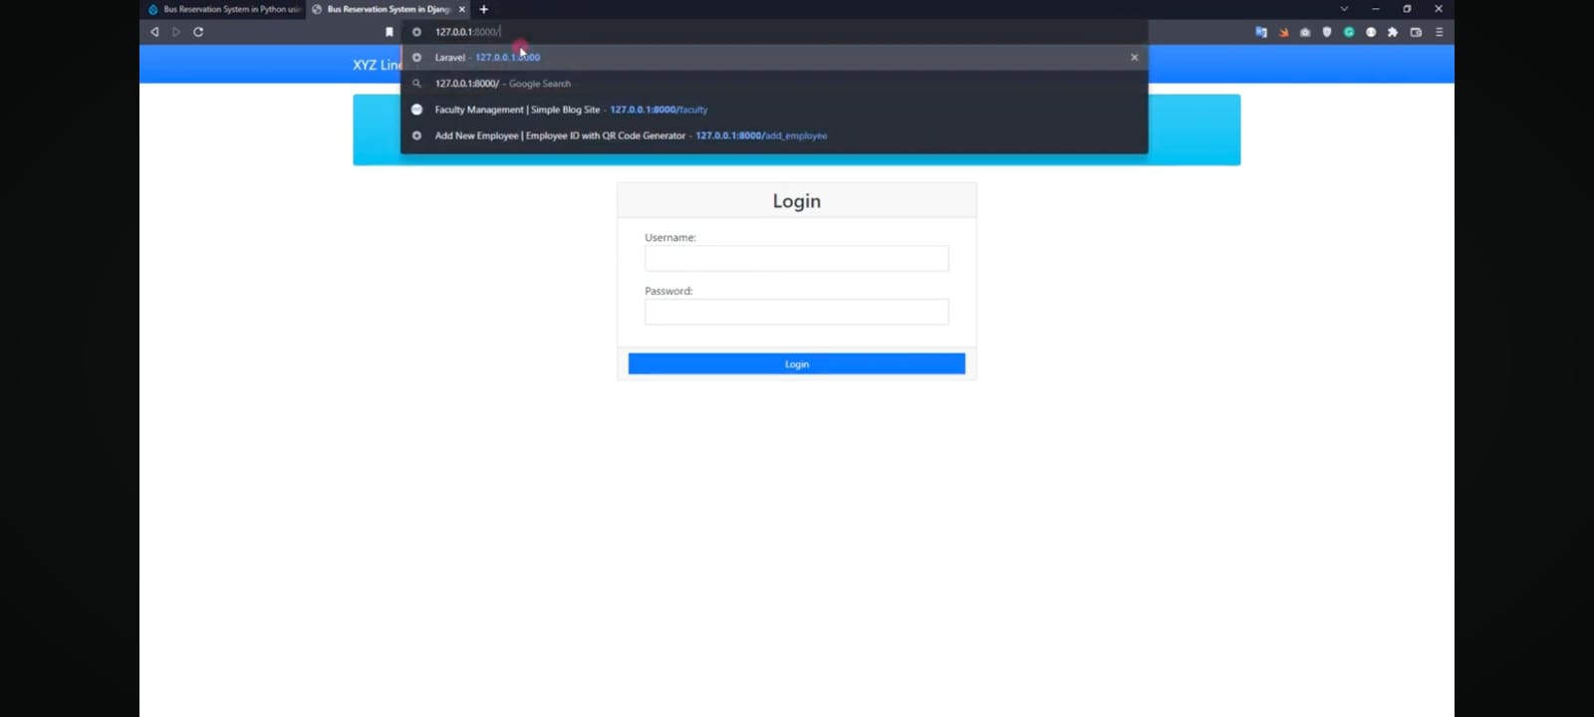
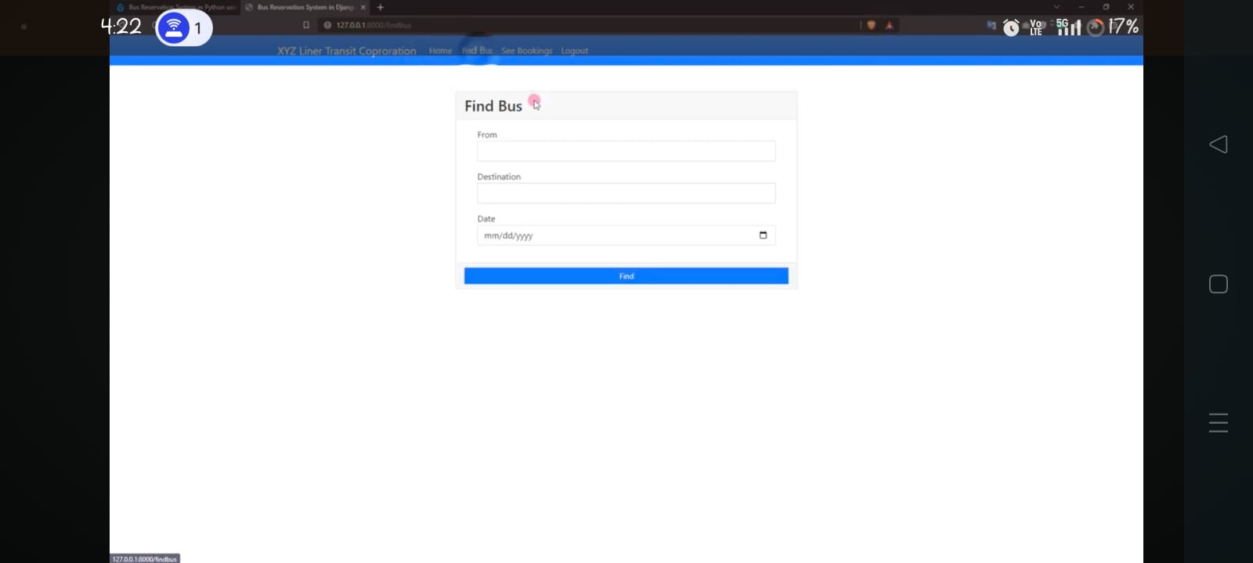
service-Page

Slide 14
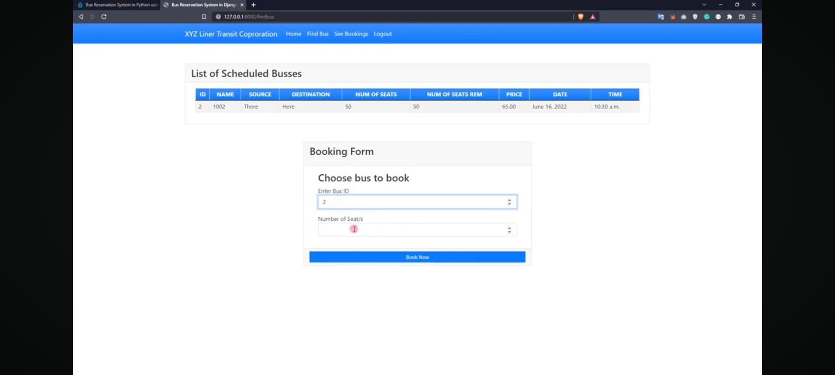
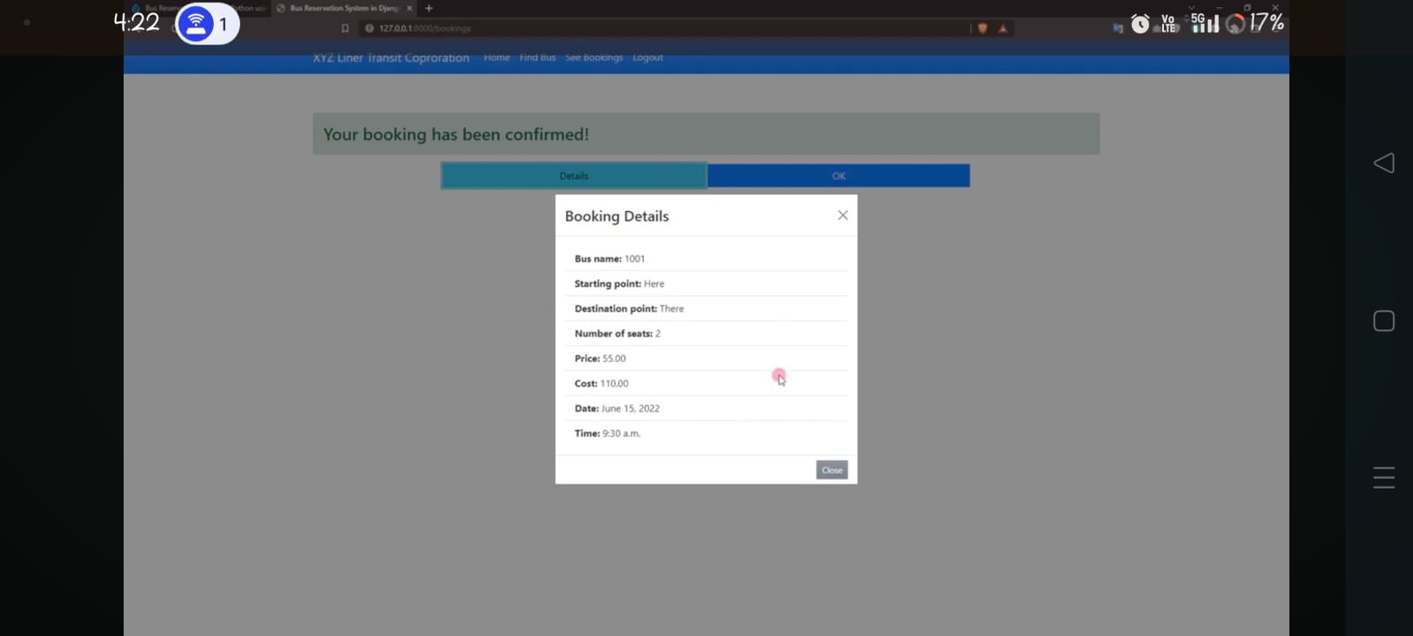
service-Page

Slide 15
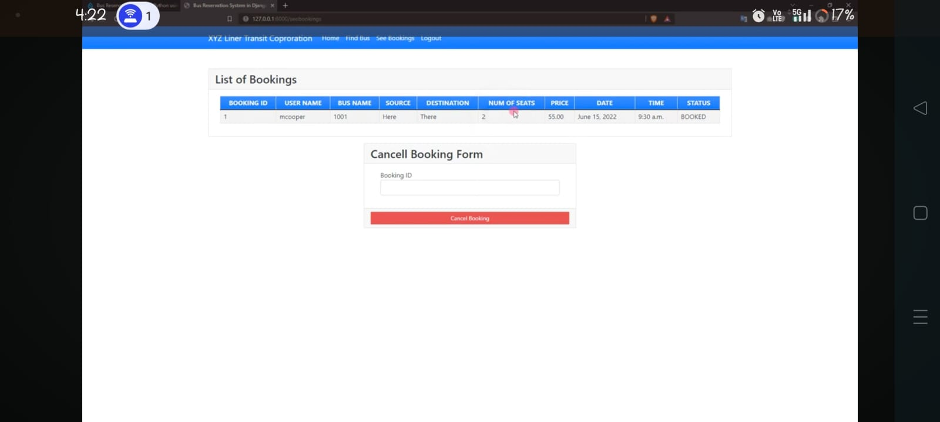
service-Page

Slide 16
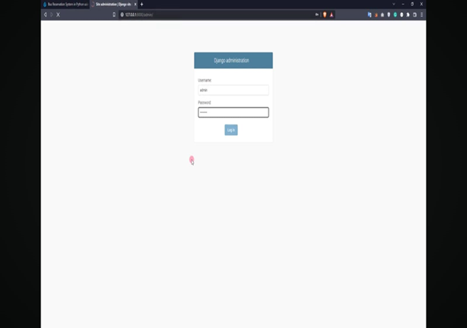
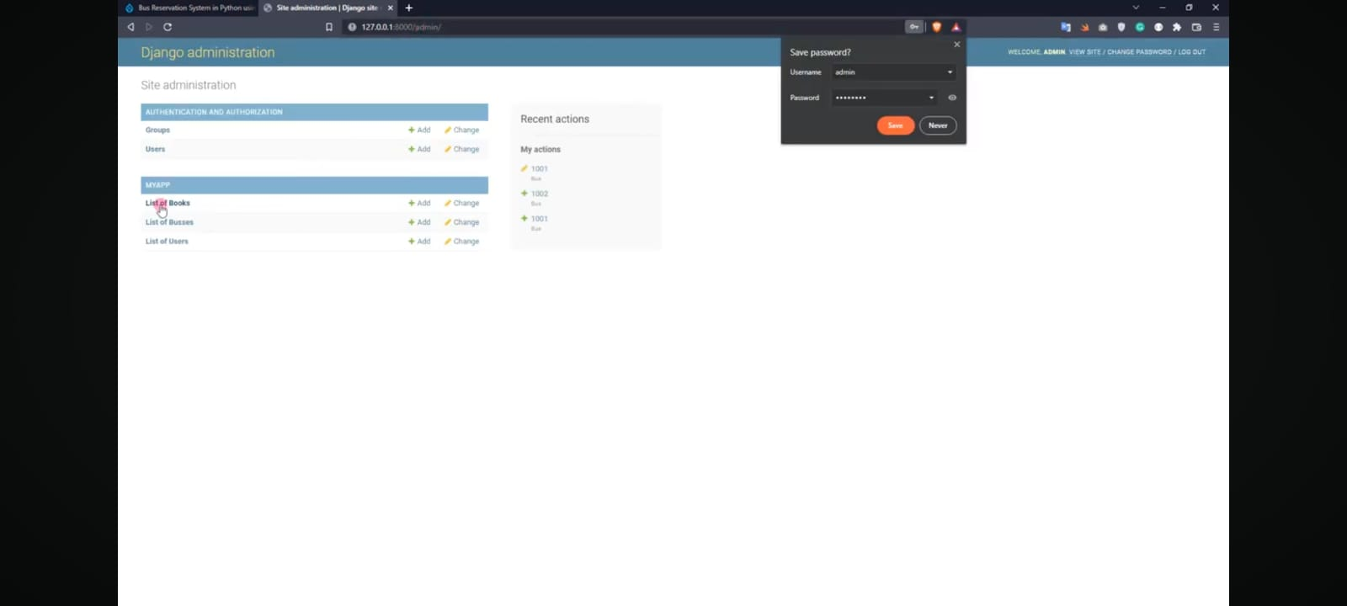
Departments-Page

Slide 17
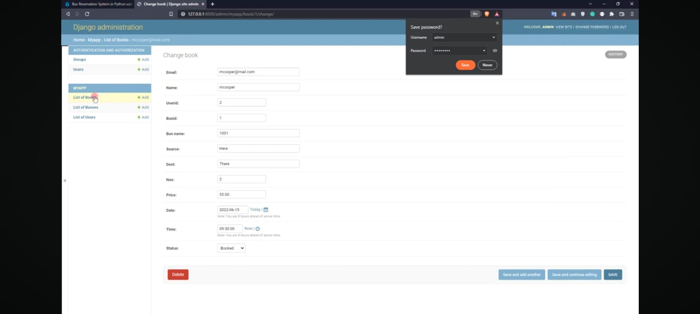
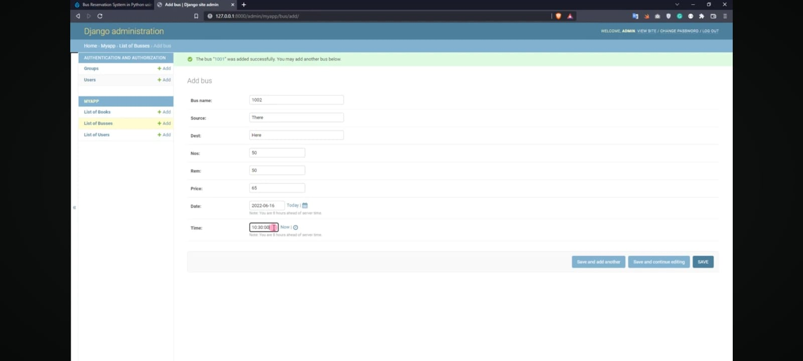
Departments-Page

Slide 18
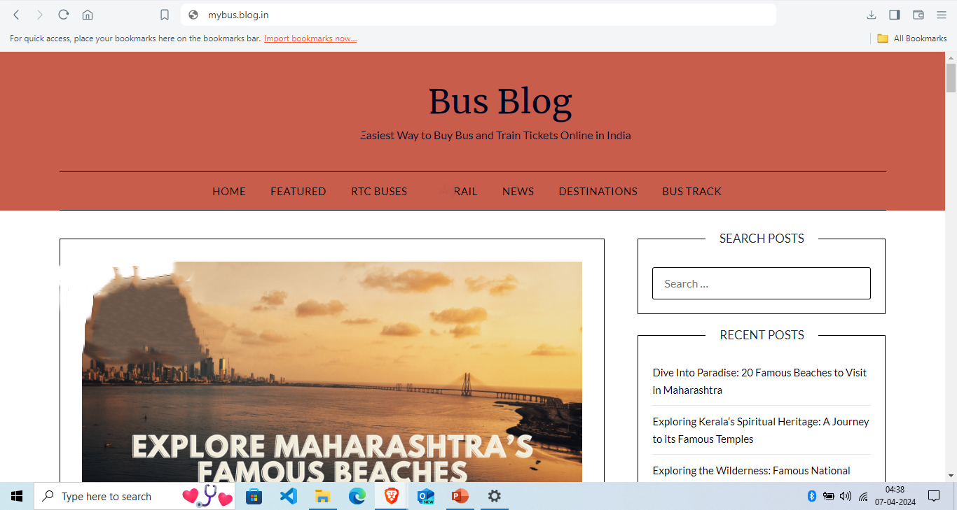
Blog-Page

Slide 19
Future Enhancements:
Integration of AI and Machine Learning: Implementing AI and machine learning algorithms can help in predicting demand for routes, optimizing schedules, and dynamically adjusting ticket prices based on factors like demand, time of booking, and historical data.
Real-time Tracking and Notifications: Advanced GPS tracking systems can provide real-time updates on the location of buses, estimated arrival times, and any delays. Passengers can receive notifications through mobile apps or SMS alerts, allowing for better planning and reduced waiting times.
Mobile Ticketing and Contactless Payments: Future systems may increasingly rely on mobile ticketing apps and contactless payment methods, reducing the need for physical tickets and cash transactions. This not only improves convenience for passengers but also streamlines the ticketing process for operators.
Customer Service Automation: Implementing chatbots and virtual assistants powered by natural language processing (NLP) can automate customer service inquiries, provide instant responses to frequently asked questions, and assist passengers throughout their journey.

Slide 20
Conclusion
The implementation of a bus reservation system offers numerous advantages for both passengers and bus operators alike. Through the utilization of advanced technologies, such as online booking platforms and mobile applications, the process of reserving seats and managing schedules becomes streamlined and efficient.
Additionally, features such as seat selection, real-time updates on bus availability, and secure payment options contribute to a more satisfying journey.
On the other hand, bus operators benefit from improved operational efficiency, as the automated reservation system helps in better managing seat inventory, optimizing routes, and minimizing overbooking or underbooking situations.
Overall, the adoption of a bus reservation system not only enhances the convenience and experience for passengers but also facilitates better management and operations for bus companies.
Source :

Slide 21
Thank You!
Notes:
Thank You !!

